Slide 1
INFO 250 Information Visualization
Week 1: Introduction and Overview

Slide 2
Course Description
Introduces the foundation and the state of the art of information visualization. Explores and reflects on the design, application, and evaluation of a variety of common data and graph types. Exposure to some basic visualization tools. Credits: 3.0 Repeat Status: Not repeatable for credit College/Department: College of Computing and Informatics Pre-requisite: None This course will have not required textbook.

Slide 3
Contact Information
Instructor Name | Bhupesh Shetty
Contact Information | bys24@drexel.edu
Office | Online (blackboard)
Office Hour | By appointment

Slide 4
Course Outcome
Upon successful completion of this course, you will be able to:
Explain fundamental principles of information visualization
Understand basic terms related to information visualization
Design and implement visual representations from raw datasets of common data types
Evaluate the quality of information visualization

Slide 5
What does it take to be a good visualization professional? (I)
Data
Method
Tool
Story-telling
All elements are essential for good visualizations.
Data is the most important element in visualization!
All tools have limitations.
Visualization is as much about way of thinking (design) as it is about technical knowledge and skills.
Notes:
Argument 1: All components are important. Do not just think visualization as some fancy tools and methods. Design and story is as important as technical implementations.
Argument 2: No hierarchical relationships among the elements, but data is the most important: (1) normally first step and (2) the basis of the rest of the work.

Slide 6
What does it take to be a good visualization professional? (II)
Data
Method
Tool
Story-telling
What is not covered by this model?
Domain knowledge
Being a critical and sensitive reader
Practice! (10,000-Hour Rule)

Slide 7
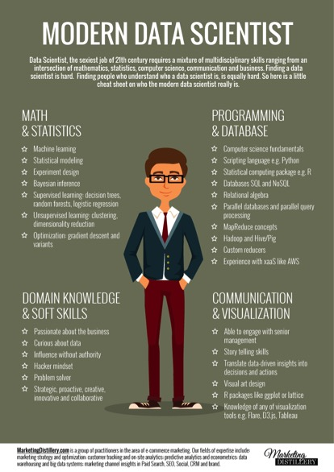
What does it take to be a good visualization professional? (III)

Slide 8
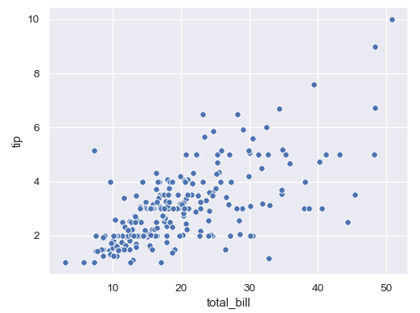
What does it take to be a good visualization professional? (III)
Questions we can ask about this visualization:
What type of graph is it?
What message does the graph convey?
How should we create it?
What type of data could make it?
What factors should be considered?
Is it based on legitimate data?

Slide 9
Coursework (I)
Structure of the class
All lectures will be f2f ☺
Will be on Mondays and Wednesdays at 04:30 pm - 05:50 pm .
Your attendance is required
All lectures will be recorded and available in Blackboard.
Do not hesitate to email me if you have any questions. If you do not receive a reply in 24 hours time, remind me again!

Slide 10
Coursework (II)
Assignments
All assignments will be discussed in the first class of the week and be due by the end of the Sunday.
Individual Projects: 6 assignments during the term
Mid-term (10)
Take-home exam (Week 5)
There will be a team final project but no final exam.
The final project will be built upon the last three assignments.
It is more of an integration of what we learn throughout this course, instead of a new project that you will need to finish.

Slide 11
Course materials
This course will have no required textbook.
All slides and videos will be shared to Blackboard after the class.

Slide 12
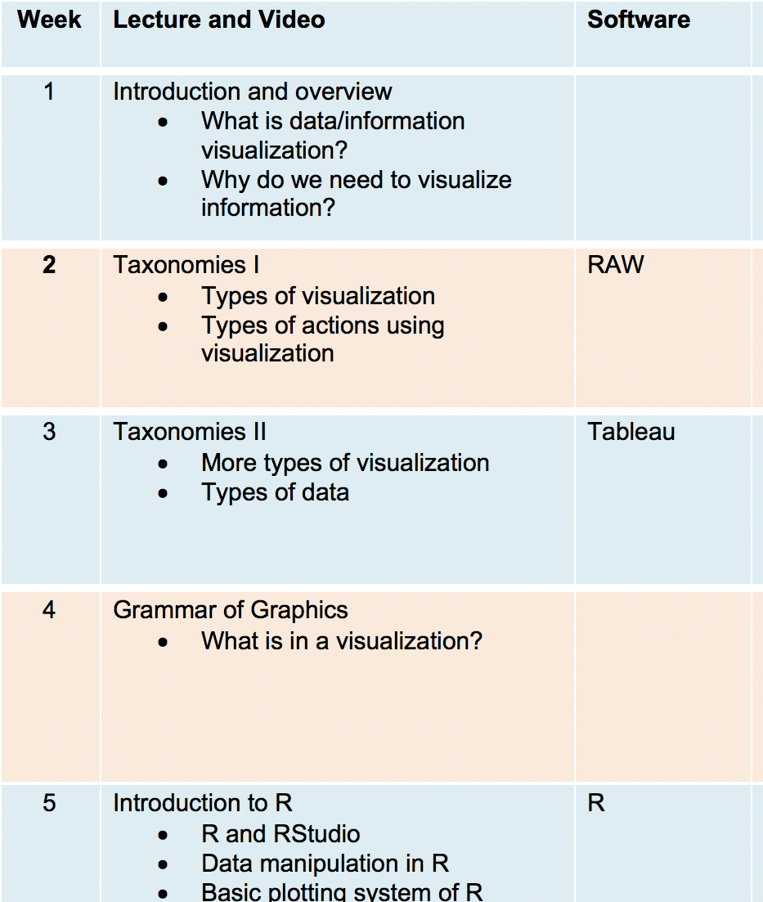
Schedule (details may change in the future)

Slide 13
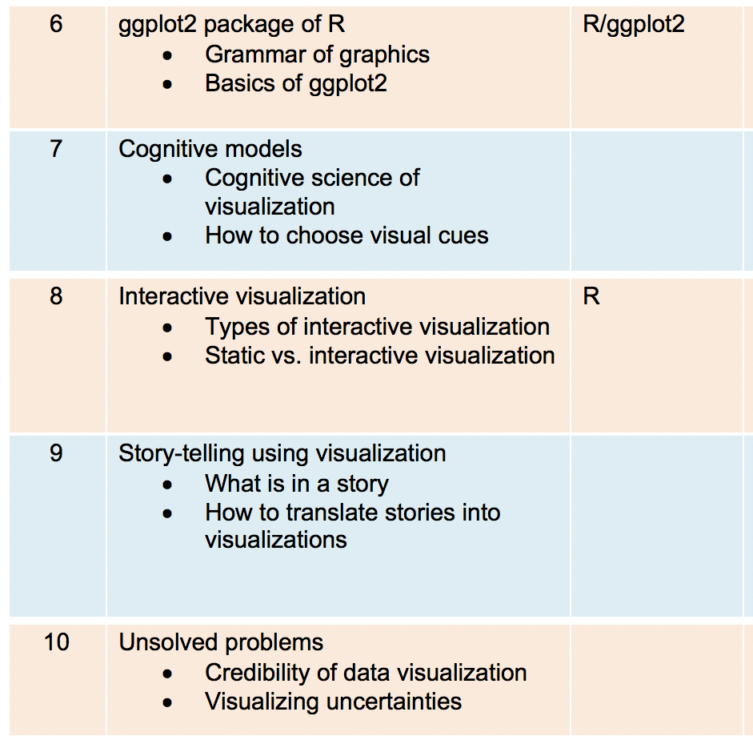

Slide 14
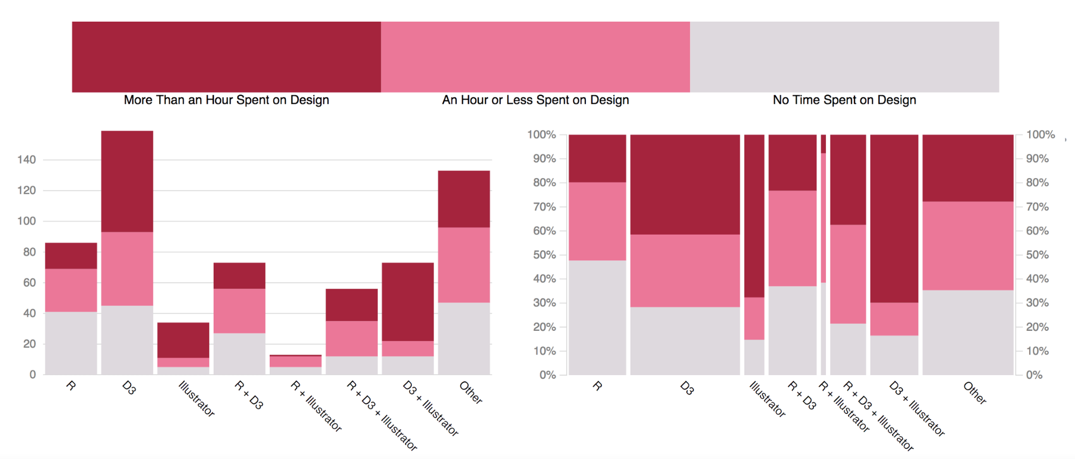
R + D3 + Adobe Illustrator
The 2018 Data Visualization Survey conducted by Data Visualization Society in early 2018 (n = 628) found that R + (D3 + )Illustrator is the most popular toolkit among “heavier” visualization professionals. Link: https://medium.com/data-visualization-society/you-can-design-a-good-chart-with-r-5d00ed7dd18e
Notes:
Specifically, an R package ggplot2 will be taught and used during the second half of this class. Some D3 related package will also be demonstrated.

Slide 15
Grading Scale
Grade | GPA | Range
A+ | 4.00 | 98.00 | 100.00
A | 4.00 | 93.00 | 97.99
A- | 3.67 | 90.00 | 92.99
B+ | 3.33 | 88.00 | 89.99
B | 3.00 | 82.00 | 87.99
B- | 2.67 | 80.00 | 81.99
C+ | 2.33 | 78.00 | 79.99
C | 2.00 | 72.00 | 77.99
C- | 1.67 | 70.00 | 71.99
D+ | 1.33 | 68.00 | 69.99
D | 1.00 | 60.00 | 67.99
F | 0.00 | 0.00 | 59.99

Slide 16
Course Policies
Late submission policy
All submissions will be done within Blackboard. Submission pages in Blackboard will remain visible for submissions until deadlines. Late submissions should be made to the Assignment named Digital Dropbox in Blackboard. Late submissions will be graded as soon as possible, although delays should be expected. If you have reasons that are beyond your control, you may request for being excused for the late penalty by emailing your request to the instructor for consideration prior to the deadline.
Penalties for late submissions:
Reduction of 20% per day after the deadline
Incomplete policy
Incomplete grades are contingent upon instructor approval and will only be considered in extenuating circumstances beyond a student’s control. The instructor is under no obligation to offer an incomplete grade. At least 70% of the graded coursework must have already been completed in order for an incomplete grade to be considered (per the recommendation of the Provost’s Office). An incomplete contract with due date for delivery of the completed work should be completed by the student and the instructor. It can be found here: https://drexel.edu/~/media/Files/provost/policies/pdf/incomplete.ashx?la=en.

Slide 17
Academic integrity, plagiarism and cheating policy
The official version of policies related to academic dishonesty can be found in the link below. It is your responsibility to read the policy carefully.
http://www.drexel.edu/provost/policies/academic_dishonesty.asp
http://www.drexel.edu/studentlife/judicial/honesty.html
Once it can be established that an academic dishonest act has been conducted in connection to any of the coursework in this class, a two-letter grade reduction will be applied to the overall course grade as a penalty. The identified incidence will be reported to the University. As the ultimate penalty, the University may withdraw a degree as a result of academic dishonesty.
Students with disability statement
http://www.drexel.edu/oed/disabilityResources/students/
Course drop policy
http://www.drexel.edu/provost/policies/course_drop.asp
http://www.drexel.edu/provost/policies/course_withdrawal_policy.asp
Course change policy
The content of the course is subject to change during the term at the discretion of the instruction. Details of change will be announced on Blackboard as soon as decisions of such change are made.
Intellectual property
http://www.drexel.edu/provost/policies/patent_policy.asp

Slide 18
